Slide 1
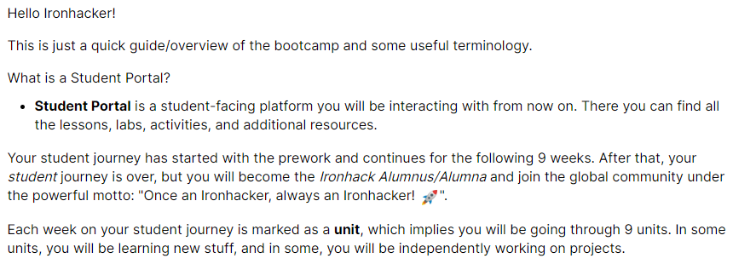

BOOTCAMP
Useful Information

Slide 2
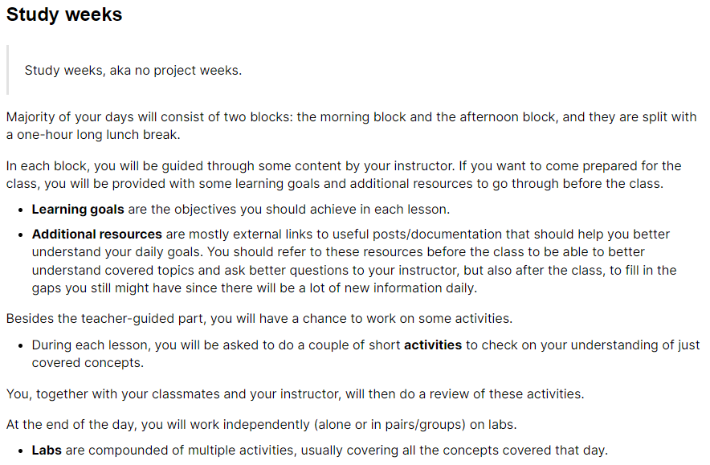
BOOTCAMP
Useful Information

Slide 3
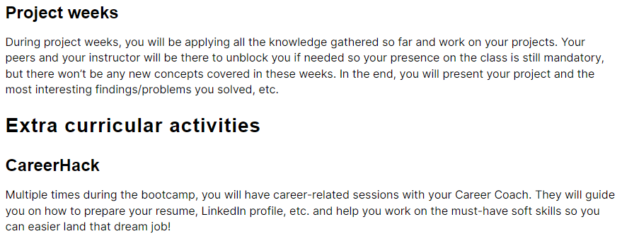
BOOTCAMP
Useful Information

Slide 4
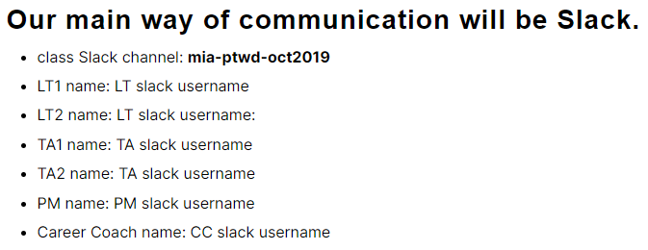
BOOTCAMP
Useful Information

Slide 5

BOOTCAMP
Week 1: Intro to Python – Data Types

Slide 6
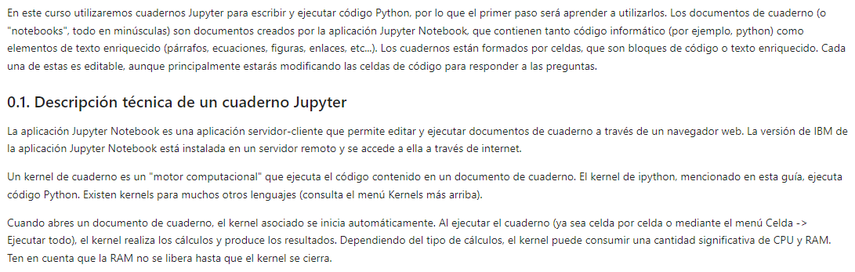
BOOTCAMP
Week 1: Intro to Python – Data Types

Slide 7
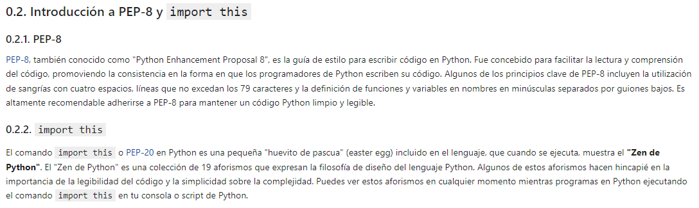
BOOTCAMP
Week 1: Intro to Python – Data Types

Slide 8
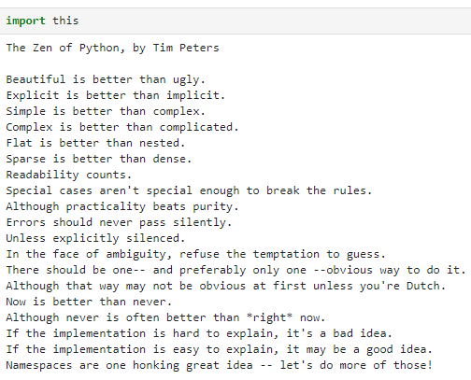
BOOTCAMP
Week 1: Intro to Python – Data Types

Slide 9
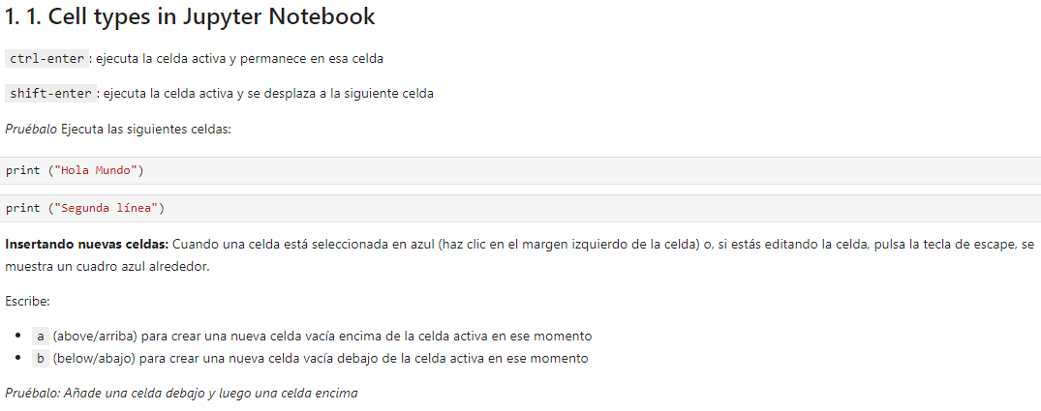
BOOTCAMP
Week 1: Intro to Python – Data Types

Slide 10
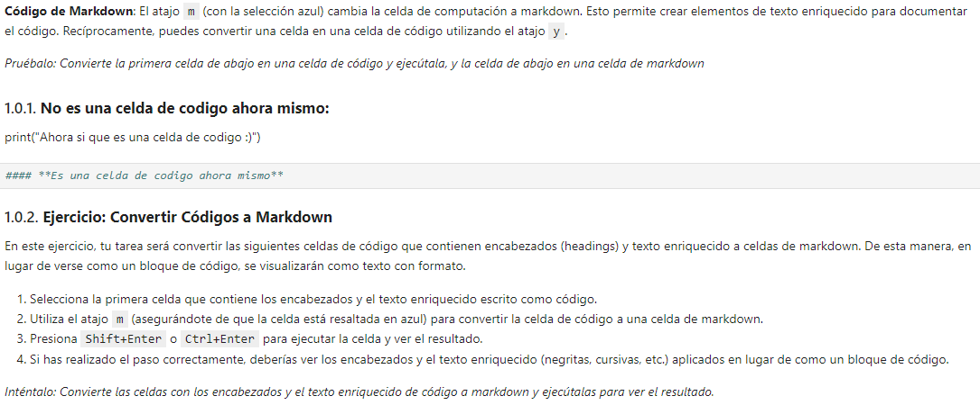
BOOTCAMP
Week 1: Intro to Python – Data Types

Slide 11
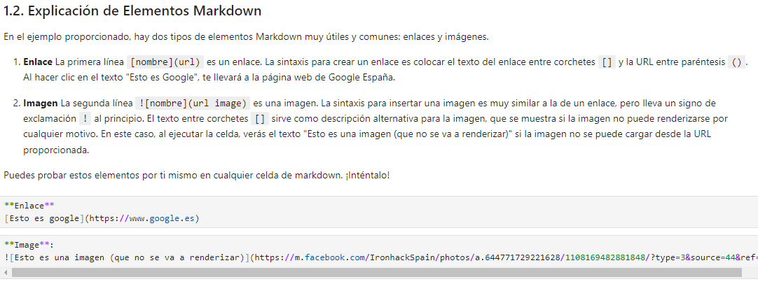
BOOTCAMP
Week 1: Intro to Python – Data Types
“Code” formats instead of “Markdown” formats

Slide 12
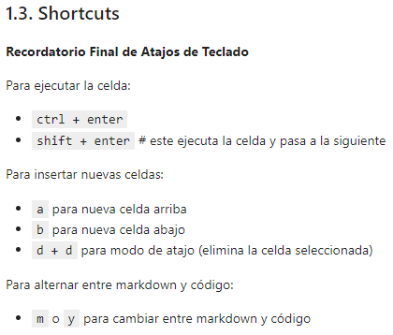
BOOTCAMP
Week 1: Intro to Python – Data Types

Slide 13
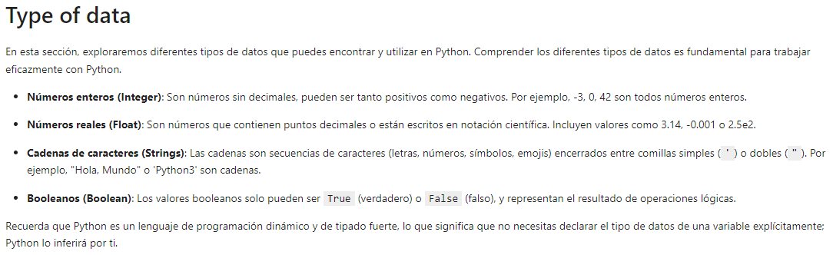
BOOTCAMP
Week 1: Intro to Python – Data Types

Slide 14
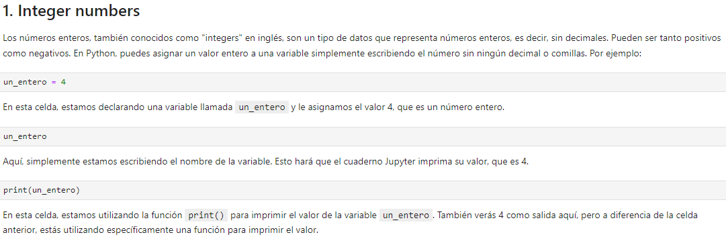
BOOTCAMP
Week 1: Intro to Python – Data Types

Slide 15
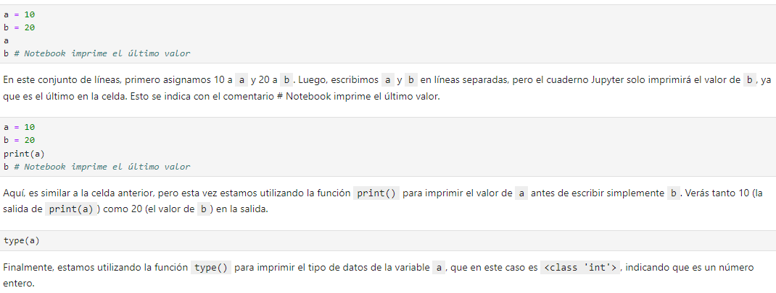
BOOTCAMP
Week 1: Intro to Python – Data Types

Slide 16
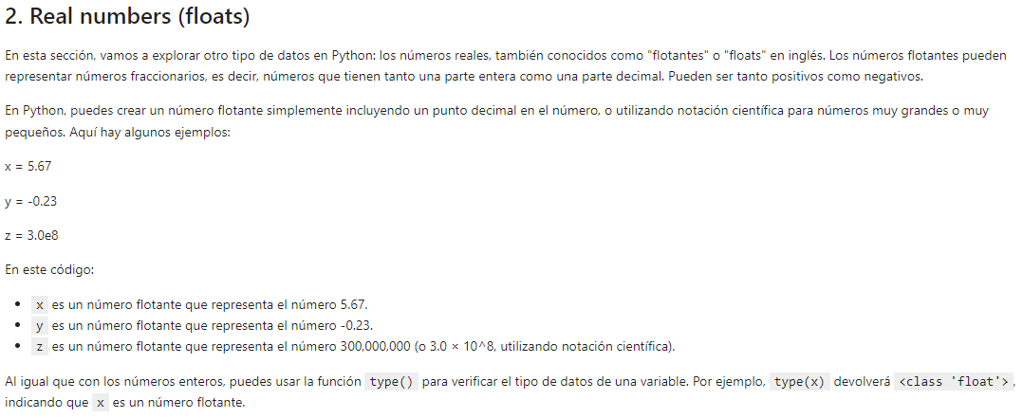
BOOTCAMP
Week 1: Intro to Python – Data Types

Slide 17
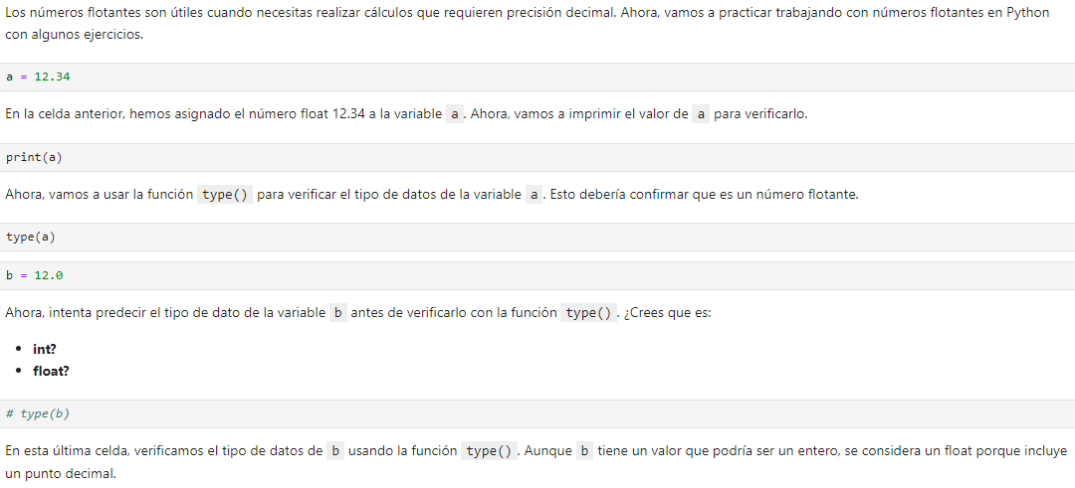
BOOTCAMP
Week 1: Intro to Python – Data Types

Slide 18
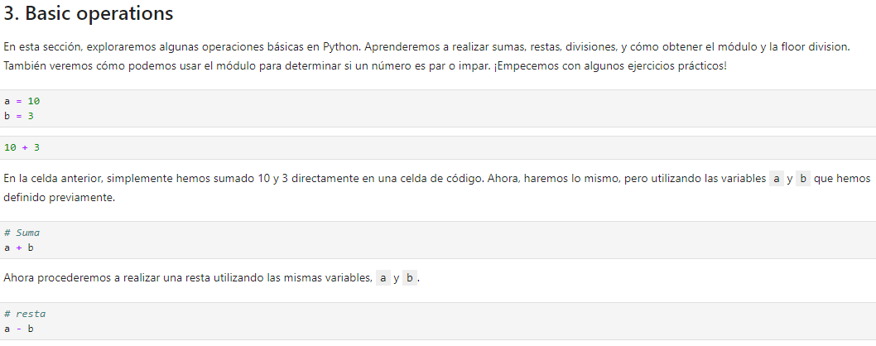
BOOTCAMP
Week 1: Intro to Python – Data Types

Slide 19
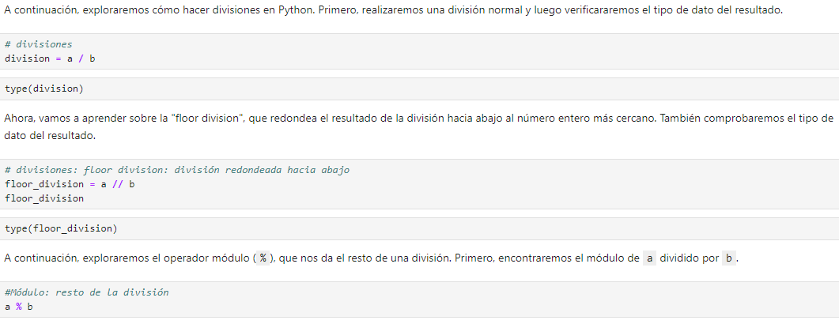
BOOTCAMP
Week 1: Intro to Python – Data Types

Slide 20
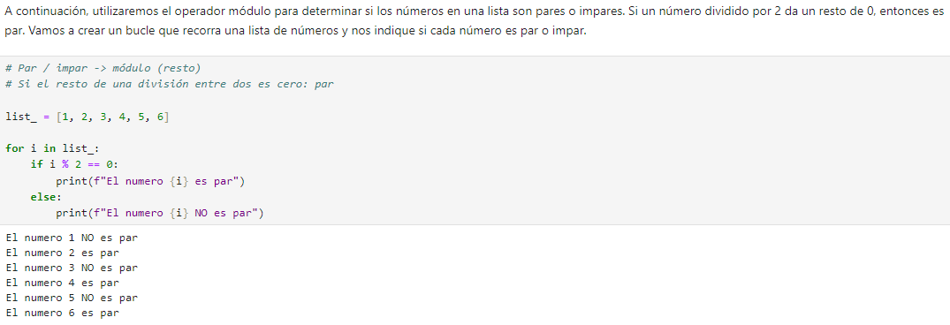
BOOTCAMP
Week 1: Intro to Python – Data Types

Slide 21
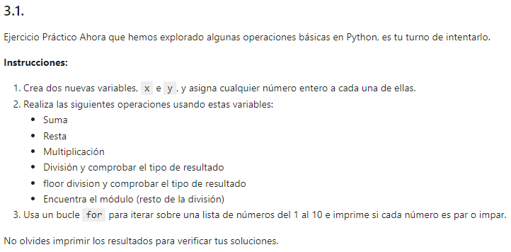
BOOTCAMP
Week 1: Intro to Python – Data Types

Slide 22
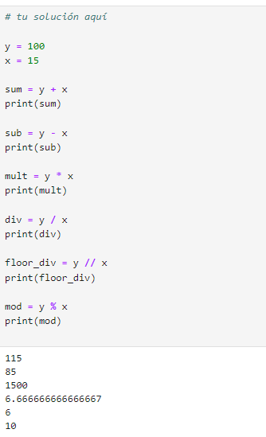
BOOTCAMP
Week 1: Intro to Python – Data Types

Slide 23
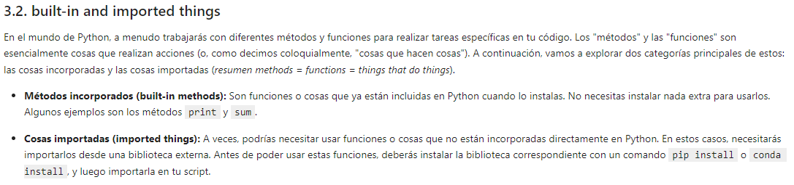
BOOTCAMP
Week 1: Intro to Python – Data Types

Slide 24
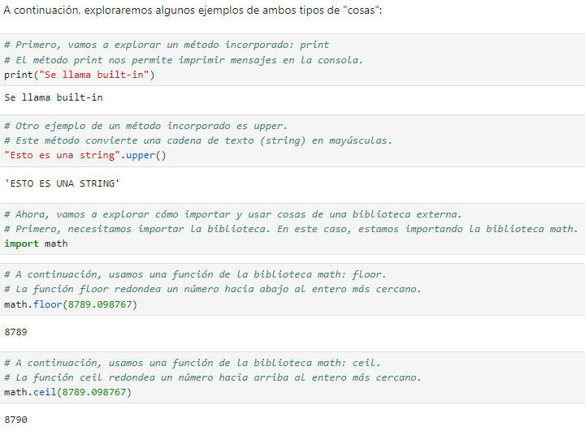
BOOTCAMP
Week 1: Intro to Python – Data Types

Slide 25
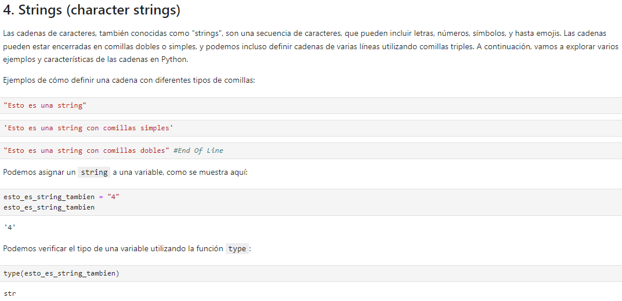
BOOTCAMP
Week 1: Intro to Python – Data Types

Slide 26
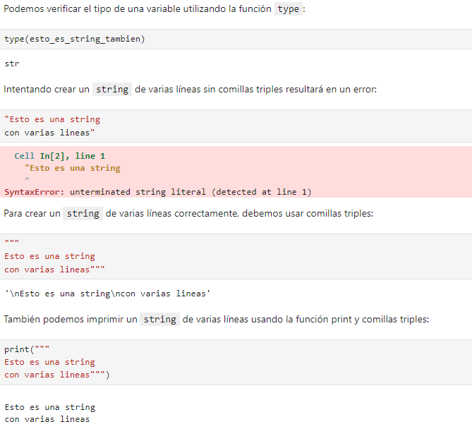
BOOTCAMP
Week 1: Intro to Python – Data Types

Slide 27
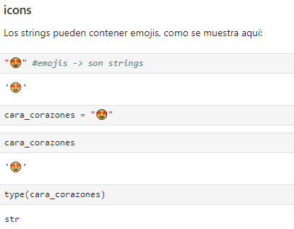
BOOTCAMP
Week 1: Intro to Python – Data Types

Slide 28
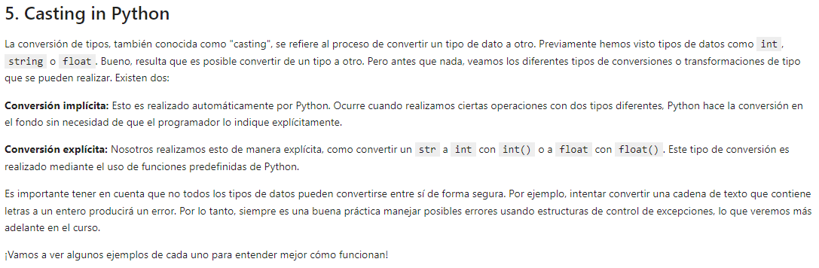
BOOTCAMP
Week 1: Intro to Python – Data Types

Slide 29
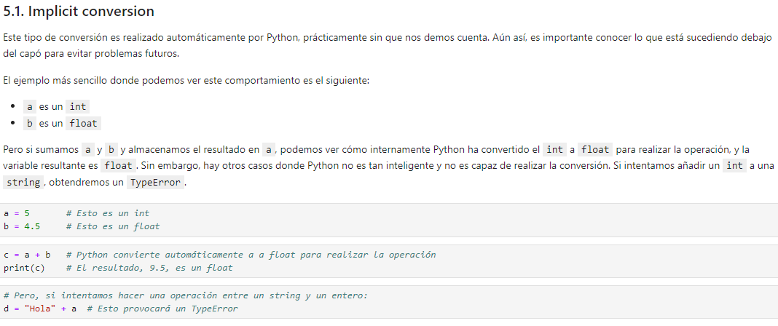
BOOTCAMP
Week 1: Intro to Python – Data Types

Slide 30
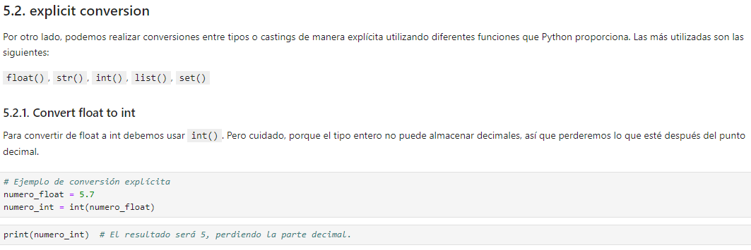
BOOTCAMP
Week 1: Intro to Python – Data Types

Slide 31
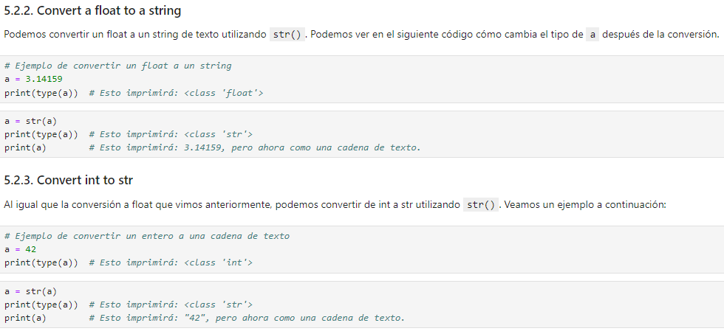
BOOTCAMP
Week 1: Intro to Python – Data Types

Slide 32
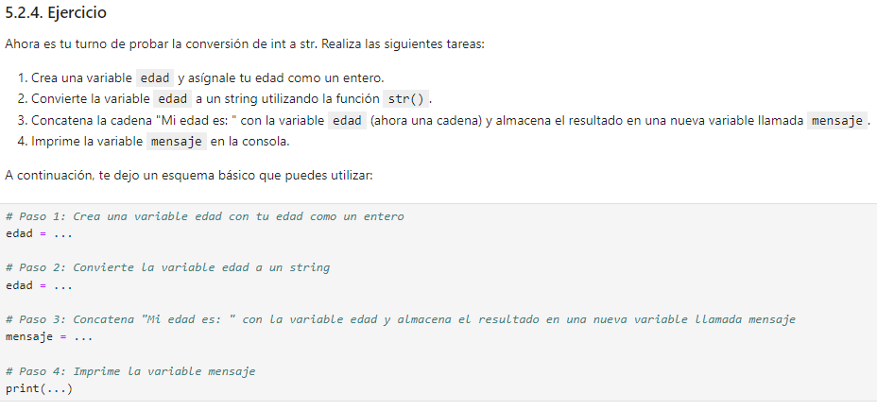
BOOTCAMP
Week 1: Intro to Python – Data Types

Slide 33
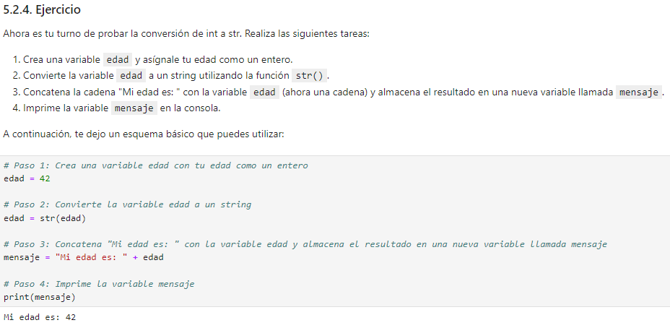
BOOTCAMP
Week 1: Intro to Python – Data Types

Slide 34
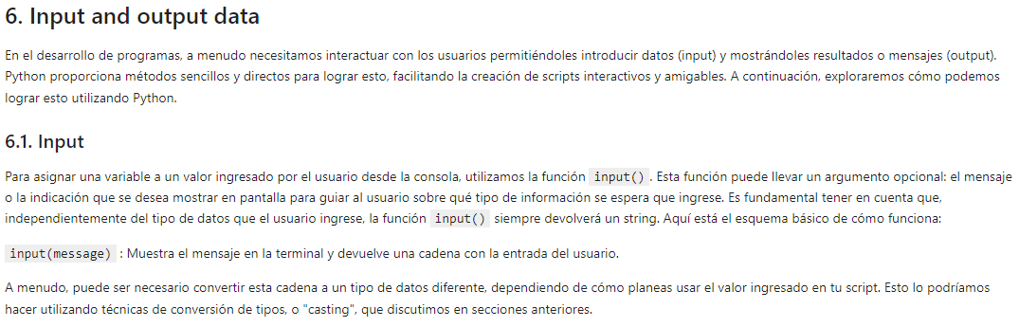
BOOTCAMP
Week 1: Intro to Python – Data Types

Slide 35
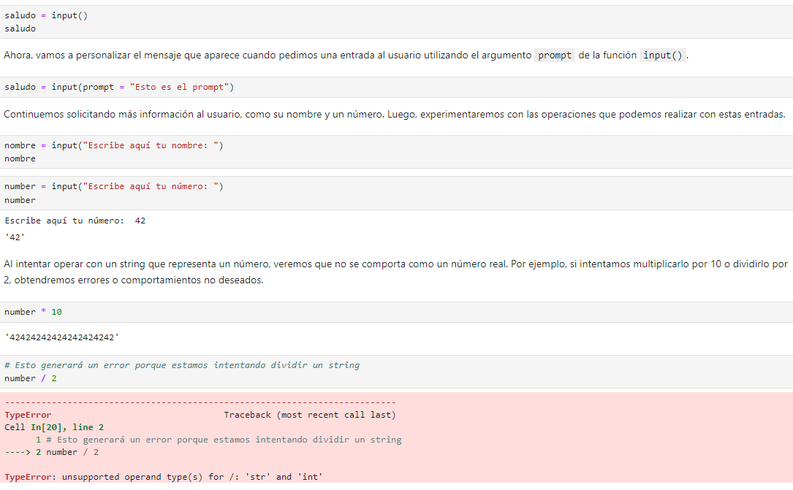
BOOTCAMP
Week 1: Intro to Python – Data Types

Slide 36
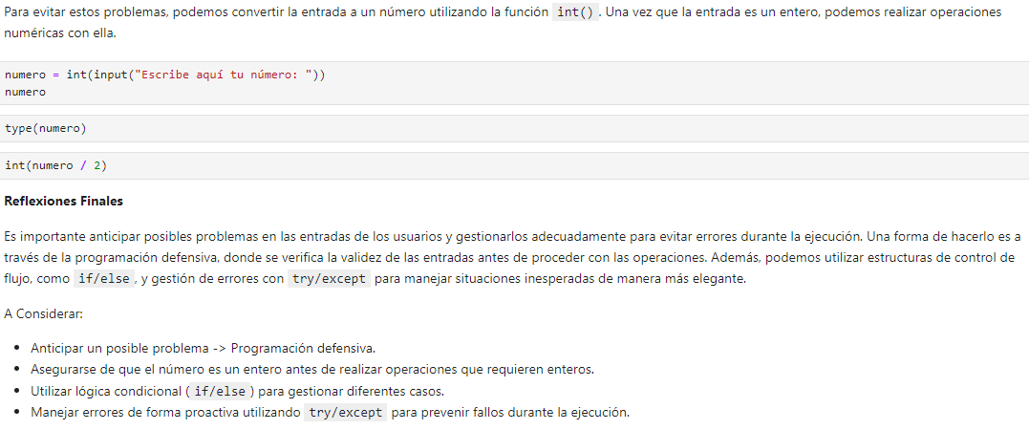
BOOTCAMP
Week 1: Intro to Python – Data Types

Slide 37
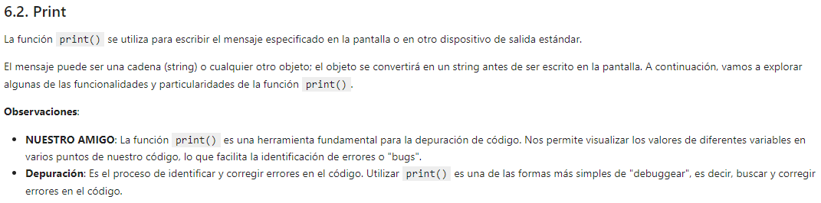
BOOTCAMP
Week 1: Intro to Python – Data Types

Slide 38
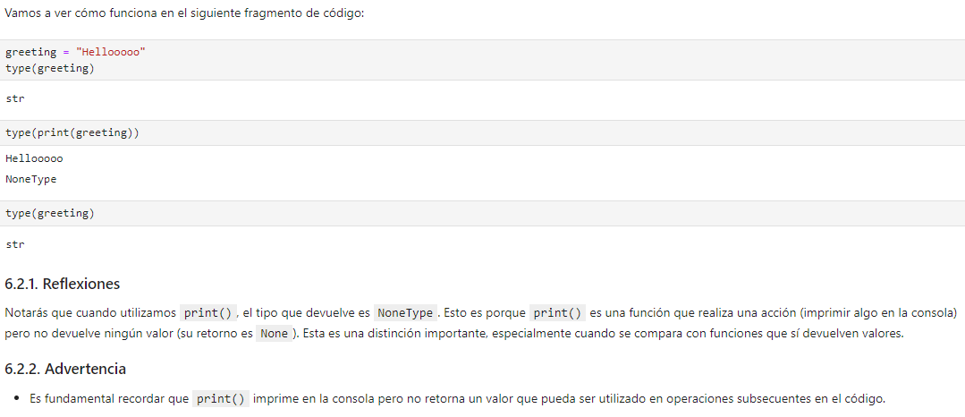
BOOTCAMP
Week 1: Intro to Python – Data Types

Slide 39
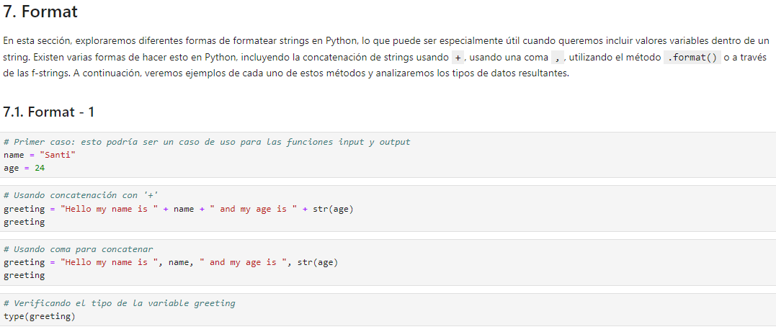
BOOTCAMP
Week 1: Intro to Python – Data Types

Slide 40
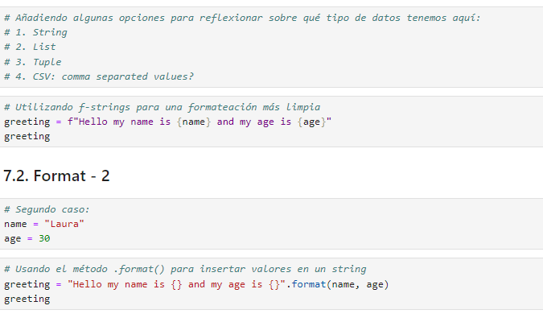
BOOTCAMP
Week 1: Intro to Python – Data Types

Slide 41
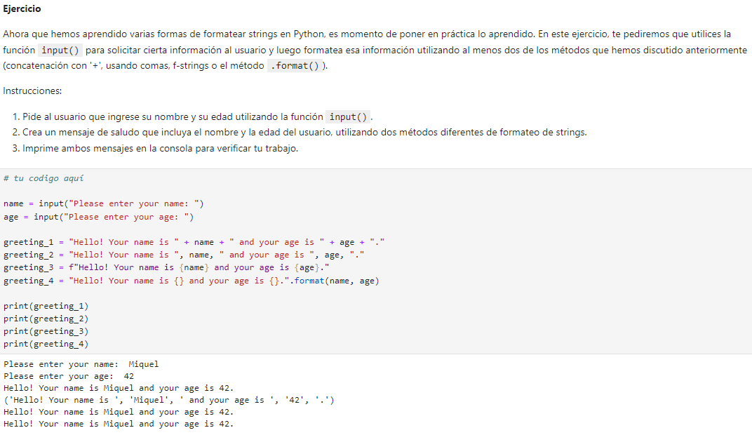
BOOTCAMP
Week 1: Intro to Python – Data Types

Slide 42
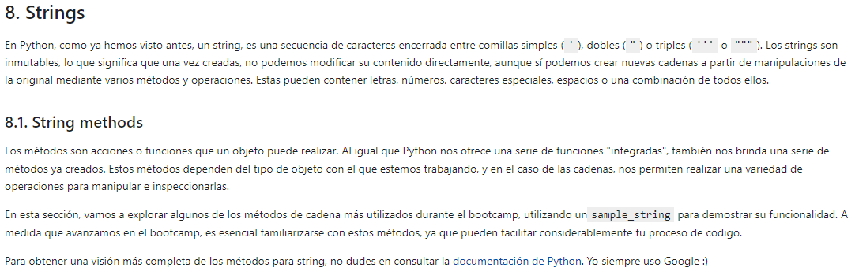
BOOTCAMP
Week 1: Intro to Python – Data Types

Slide 43
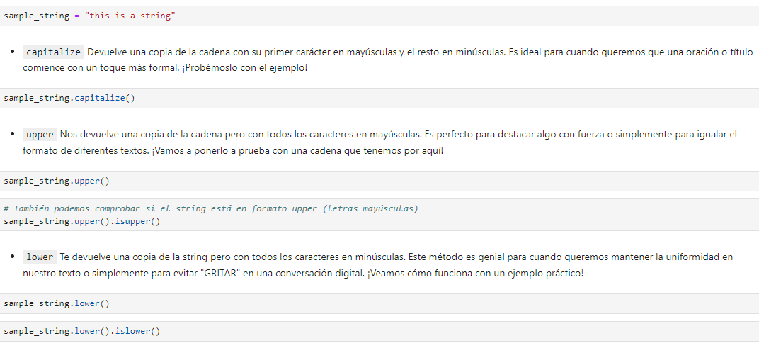
BOOTCAMP
Week 1: Intro to Python – Data Types

Slide 44
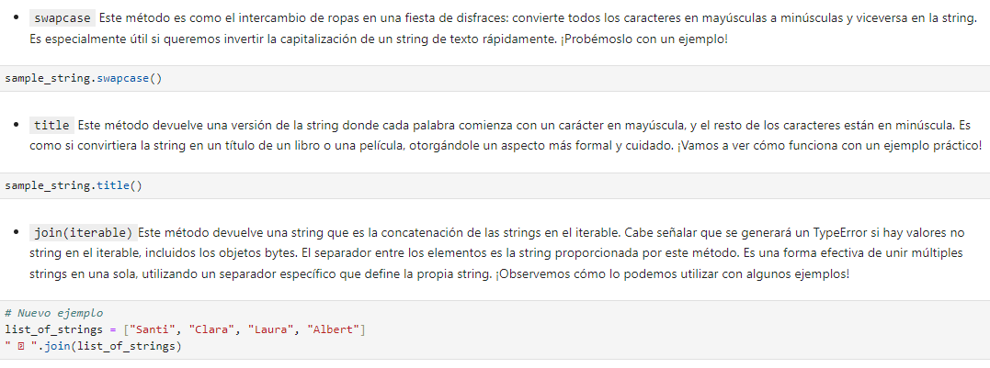
BOOTCAMP
Week 1: Intro to Python – Data Types

Slide 45
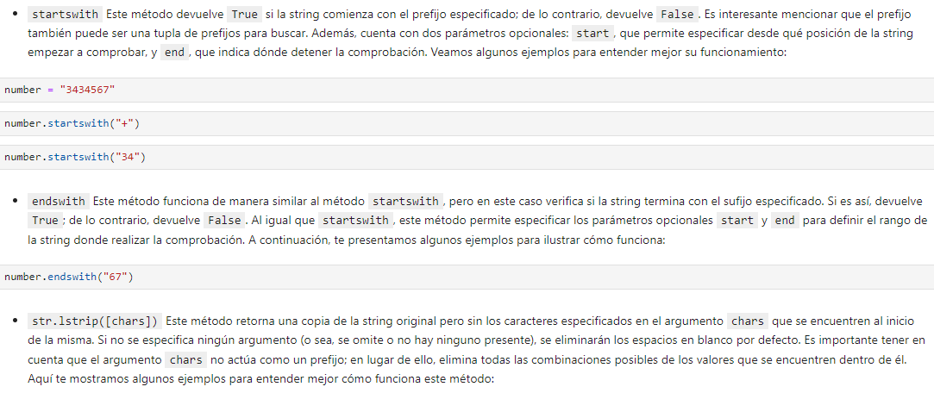
BOOTCAMP
Week 1: Intro to Python – Data Types

Slide 46
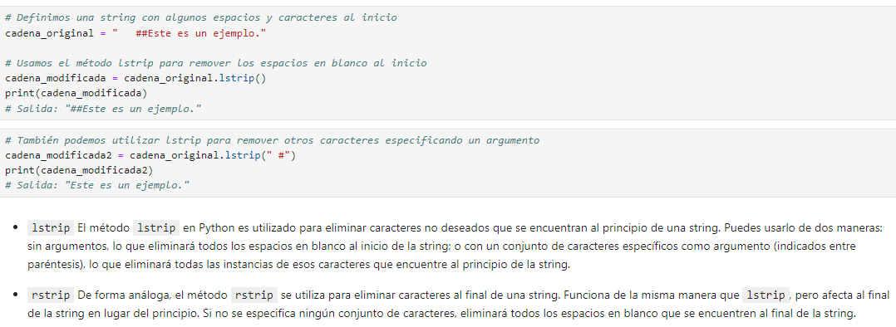
BOOTCAMP
Week 1: Intro to Python – Data Types

Slide 47
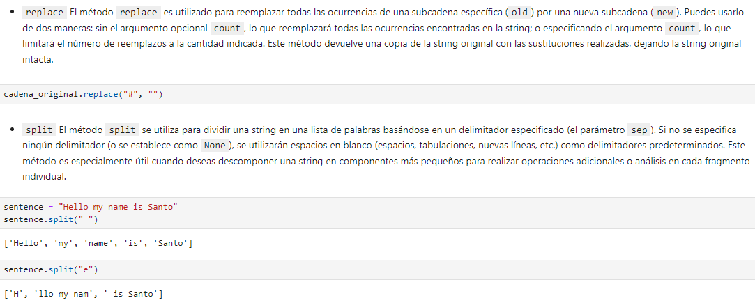
BOOTCAMP
Week 1: Intro to Python – Data Types

Slide 48
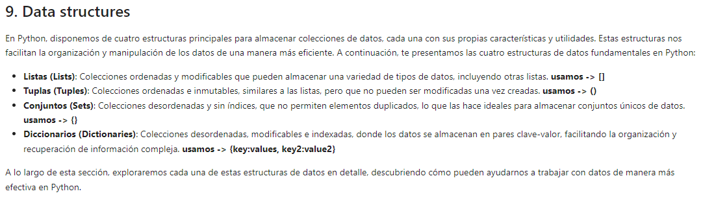
BOOTCAMP
Week 1: Intro to Python – Data Types

Slide 49
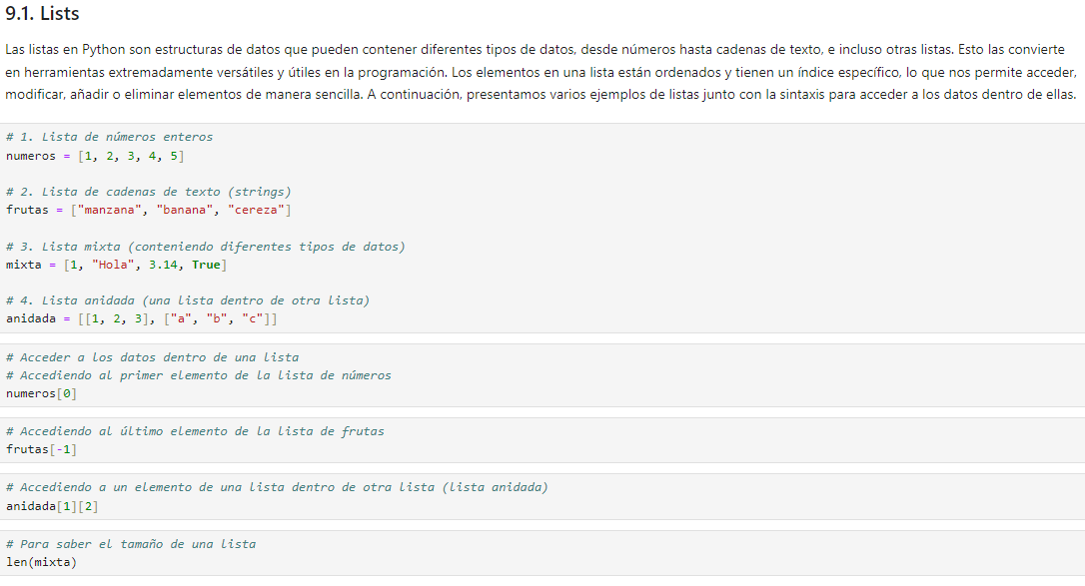
BOOTCAMP
Week 1: Intro to Python – Data Types

Slide 50
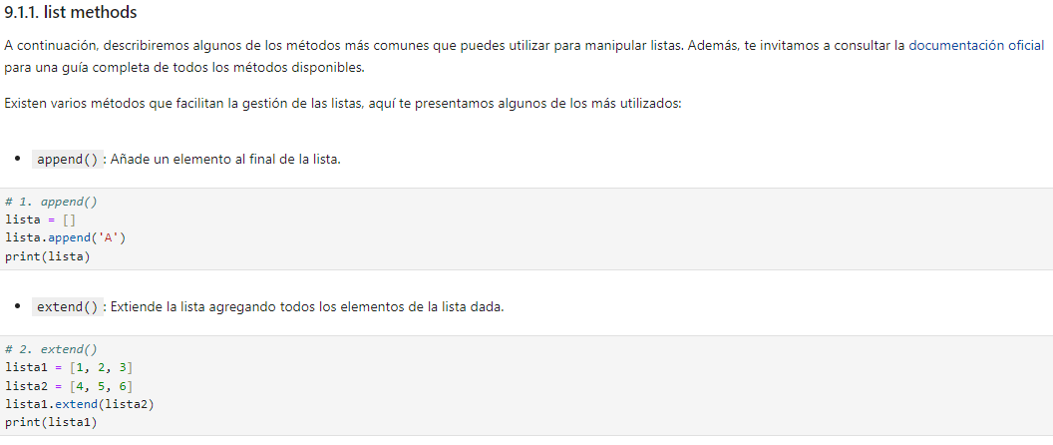
BOOTCAMP
Week 1: Intro to Python – Data Types

Slide 51
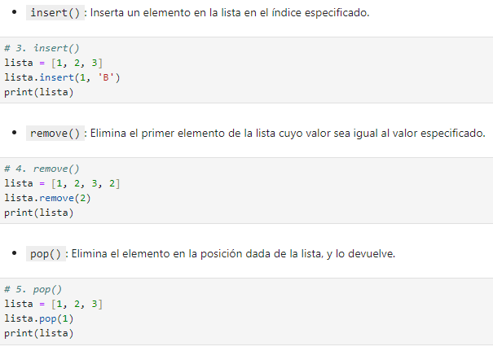
BOOTCAMP
Week 1: Intro to Python – Data Types

Slide 52

BOOTCAMP
Week 1: Intro to Python – Data Types
Very common to use this method along with “max”, “min”, “average”,…

Slide 53

BOOTCAMP
Week 1: Intro to Python – Data Types

Slide 54

BOOTCAMP
Week 1: Intro to Python – Data Types

Slide 55

BOOTCAMP
Week 1: Intro to Python – Data Types

Slide 56

BOOTCAMP
Week 1: Intro to Python – Data Types

Slide 57

BOOTCAMP
Week 1: Intro to Python – Data Types

Slide 58

BOOTCAMP
Week 1: Intro to Python – Data Types

Slide 59

BOOTCAMP
Week 1: Intro to Python – Data Types

Slide 60

BOOTCAMP
Week 1: Intro to Python – Data Types

Slide 61

BOOTCAMP
Week 1: Intro to Python – Data Types

Slide 62

BOOTCAMP
Week 1: Intro to Python – Data Types

Slide 63

BOOTCAMP
Week 1: Intro to Python – Data Types

Slide 64

BOOTCAMP
Week 1: Intro to Python – Data Types

Slide 65

BOOTCAMP
Week 1: Intro to Python – Data Types

Slide 66

BOOTCAMP
Week 1: Intro to Python – Data Types

Slide 67

BOOTCAMP
Week 1: Intro to Python – Data Types

Slide 68

BOOTCAMP
Week 1: Intro to Python – Data Types

Slide 69

BOOTCAMP
Week 1: Intro to Python – Data Types

Slide 70

BOOTCAMP
Week 1: Intro to Python – Data Types

Slide 71

BOOTCAMP
Week 1: Intro to Python – Data Types

Slide 72

BOOTCAMP
Week 1: Intro to Python – Data Types

Slide 73

BOOTCAMP
Week 1: Intro to Python – Data Types

Slide 74

BOOTCAMP
Week 1: Intro to Python – Data Types

Slide 75
BOOTCAMP
Week 1: Intro to Python – Data Types

Slide 76
BOOTCAMP
Week 1: Intro to Python – Data Types

Slide 77
BOOTCAMP
Week 1: Intro to Python – Data Types

Slide 78
BOOTCAMP
Week 1: Intro to Python – Data Types

Slide 79
BOOTCAMP
Week 1: Intro to Python – Data Types

Slide 80
BOOTCAMP
xxxxxxxxxxxxxxx

